Slide 1
SIXTH FORM OPEN EVENING
RAMSEY GRAMMAR SCHOOL

Slide 2
The importance of GCSE grades
They will determine whether or not you can join the Sixth Form
The minimum entry requirements for RGS sixth form are generally
5 GCSE passes at C+ with English and/or Maths.

Slide 3
The importance of GCSE grades
They could determine the qualifications you take next
You need at least a C grade pass in most subjects to take an A level course. Some subjects require at least grade B in that subject.

Slide 4
The importance of GCSE grades
They will be used to assess if you’re suitable for a university course
University courses look for at least Cs in GCSE English, Maths and perhaps Science. Some university courses go further and ask for specific subjects at GCSE, with certain grades.
A Management degree at the University of Leeds, for example, specifies that you must have at least Bs in English language and Maths under your belt, while a Psychology degree at Newcastle University asks for ‘Maths, English and Science at grade B, but ‘grade A preferred’.

Slide 5
The importance of GCSE grades
Engineering courses such as chemical engineering: you’ll usually need A-levels or equivalent in chemistry and maths, and physics for other engineering courses, which in turn means you’ll need to have good GCSE grades - in this case, at least BB in science and a B (if not an A) in maths

Slide 6
The importance of GCSE grades
Medicine: competitive courses like medicine will ask for a whole suite of GCSEs. The University of Manchester, for example, specifies ‘applicants must offer at least 5 A* or A grades.’
The minimum grade in each of English Mathematics and all science subjects is B.
Science plus additional Science (double certificate) is acceptable
Re-sits are not accepted unless in exceptional circumstances

Slide 7
The importance of GCSE grades
Social work and secondary teaching: these professions won’t consider you without at least a C in maths and English language at GCSE

Slide 8
The importance of GCSE grades
Nursing and primary school teaching:
Cs in GCSE English, Maths and Science.

Slide 9
Post 16 qualifications
Most students study 3 A levels.
Students with an A*/A GCSE profile may study 4 A levels.
All students are expected to follow an enrichment programme to “boost” their CV.

Slide 10
Post 16 qualifications
The A level qualification
Courses are now linear with exams taken at the end of Year 13
Some “I” (International) A levels (Maths, Physics, Chemistry, Geography)have an AS component taken in June or November of Year 12
A level qualifications are required for university entrance and for entrance to many spheres of employment at age 18

Slide 11
Post 16 qualifications
BTECs are vocational qualifications :e.g. Music Performance, Physical Education, Health and Social Care and Agriculture
One of the main differences between BTECs and A-Levels is the way both are assessed. BTECs are continually assessed via coursework and practical projects. A level 3 BTEC will usually get you onto a related course at university, courses such as Business, Computing, Construction, Art, Sports Sciences and Healthcare are particularly popular with BTEC students.

Slide 12
1. If you know what you want to study at university?
Check the entry requirements on university websites or UCAS course search to find out whether the course requires certain subjects at level 3

Slide 13
2. Not sure yet? Keep your options open!
For traditional courses, such as law, and traditional universities such as those in the Russell group include at least 2 former “facilitating subjects” in your choices.

Slide 14
What are “facilitating subjects”?
Maths
English Literature
Physics
Chemistry
Biology
Geography
History
Languages

Slide 15
GCSEs matter!!!
Check the GCSE requirements for certain courses at university. Are you on track to achieve the grades at GCSE that certain courses require?

Slide 16
Think balance
Balance of subject choices that reflect your abilities, strengths and interests? Have you considered course combinations? Check: http://university.which.co.uk/advice/what-a-levels-do-you-need-for-the-degree-you-want-to-study

Slide 17
Make sure you know WHY you want to study a subject
Reasons may include
You have enjoyed a subject and have been good at the subject in the past

Slide 18
Make sure you know WHY you want to study a subject
Reasons may include
You will need a particular subject to enter a specific course or career

Slide 19
Make sure you know WHY you want to study a subject
Reasons may include
You have not studied a particular subject before but you have looked into it and think it will suit your strengths

Slide 20
Make sure you know WHY you want to study a subject
Some subjects are distinctly more difficult at A level than at GCSE
Get your facts straight – there are many misconceptions about subjects required for university and careers.
Do not make an uninformed choice – what is the new subject actually about?

Slide 21
If you are considering a career on the Isle of Man….

Slide 22
Our Aims
To work with students and parents to ensure that our young people achieve not only academically but also develop the skills and attributes which are essential to success in later life:
“To be all they can be”
EXCELLENCE FOR ALL

Slide 23
Most students study three chosen subjects
Classes are not set by ability
Students have self-study lessons
Work outside lessons is assumed and expected
Students sign up for an Enrichment Activity
Senior Games as usual

Slide 25
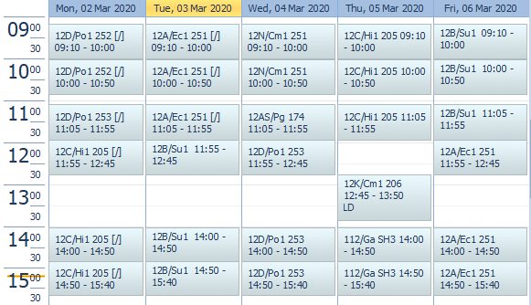

Slide 26
Subjects

Slide 27
Choose the right subjects….

Slide 28
Choose the right subjects….
Research all the options available!

Slide 30
Enrichment

Slide 31
Enrichment (building soft skills)

Slide 32
Aim Higher

Slide 33
Self Study

Slide 34
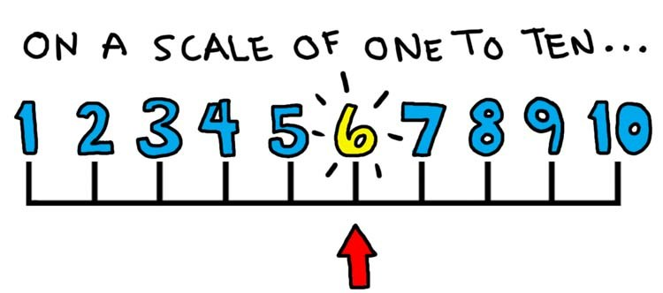
Not really working
3-4 hours – the odd free – a little at home.
Hard work.
10 -12 hours a week outside lessons.
The hardest you’ve ever worked.
20 hours a
week outside lessons.

Slide 36
Keys to Success
Vision
Effort
Systems
Practice
Attitude

Slide 37
Keys to Success
Vision

Slide 39
Preparing you for life after RGS…whatever form that takes!

Slide 40
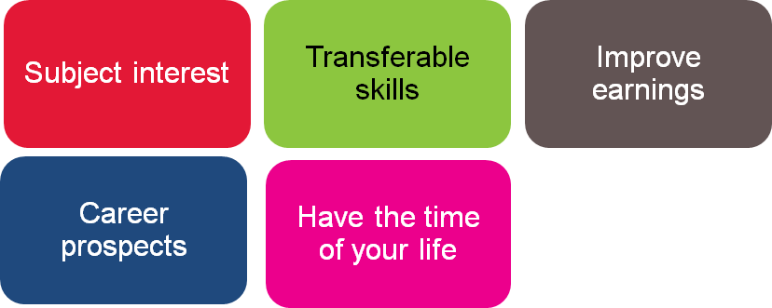
Why University?

Slide 41
The Graduate Premium

Slide 42
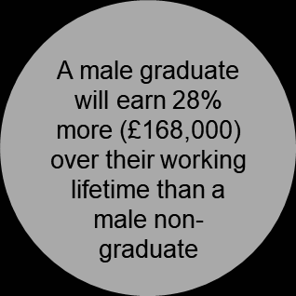
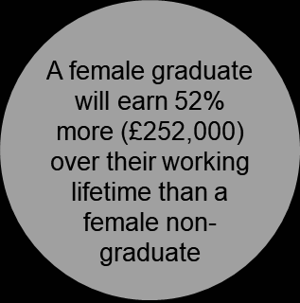
Why University?

Slide 43
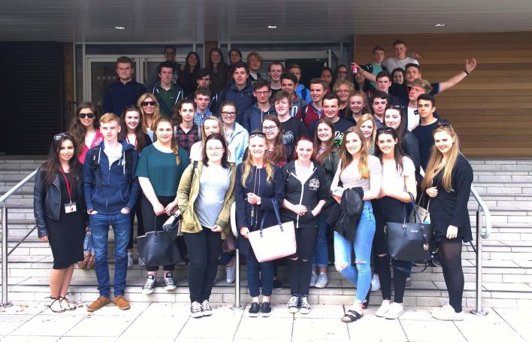
Dedicated Lessons
& family information evenings
June: IOM HE fair
July: Collaboration university trip
and University of Oxford trip

Slide 44
24 Universities covered last year

Slide 45
www.informedchoices.ac.uk

Slide 46
Mental Health and Well Being
Walk and Talk
Yoga
Living Away from Home – cooking on a budget!
Fun sports!
Art Therapy
Positive mind set exercises and anxiety management
Quay Fitness sessions
Craft sessions
Music Therapy

Slide 47
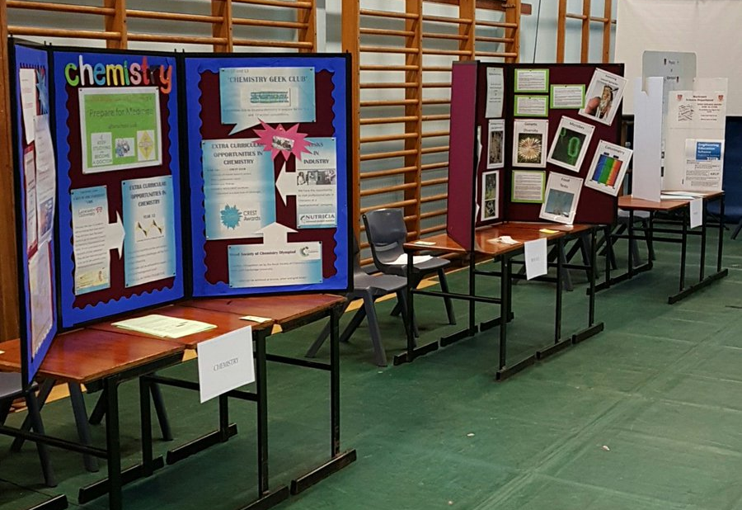
Thank you
Hector Duff Centre
West Hall

