Slide 1
What you need to know about GCSE Maths

Slide 2
The Options
Currently we have Sets 1-6 studying the Welsh Exam Board WJEC. This allows for us to continue with lettered grades (A*-G) instead of numbered grades.
Set 7 are focusing on Entry Level Qualifications at this year with a view to sit their GCSE once completing the Entry Level

Slide 3
The Tiers
There are 3 tiers in WJEC Mathematics:
Higher (Grades A*-C) Sets 1 & 2
Intermediate (Grades B-E) Sets 3, 4, 5
Foundation (D-G) Sets 6/7 (once Entry Level is completed)

Slide 4
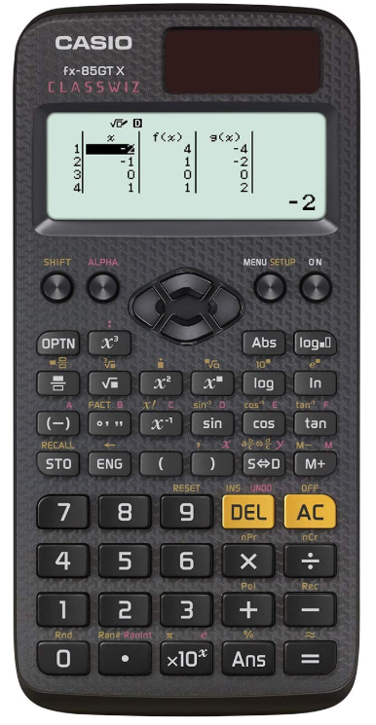
Equipment
Students will need the following equipment in order to be successful in both lessons and during exams.
Black Pen (Ball-point for exam requirement)
Pencil
Ruler (30cm)
Protractor
Compass
Scientific Calculator (Preferably a CASIO)
It is important that students are regularly attending lessons with the correct equipment so they know how to use it in the exam.

Slide 5
The Papers
For all tiers there are 2 papers to sit.
Higher/Intermediate are 1 Hour and 45 minutes long.
Foundation are 1 Hour and 30 minutes long
There is a non-calculator and a calculator paper.
All papers have a formula page on the second page and will also have 2 marks awards for Quality of Written Communication (QWC).

Slide 6
QWC
There are 2 marks available in WJEC for Quality of Written Communication (QWC).
QWC marks are awarded for how the students have explained their answers. Examiners are not looking for paragraphs but they will be focusing on how they have presented the answers (logical manner, correct use of mathematical symbols, all workings shown) and how they have explained their steps (have they made it clear what they are doing, have they used correct punctuation and spellings)

Slide 7
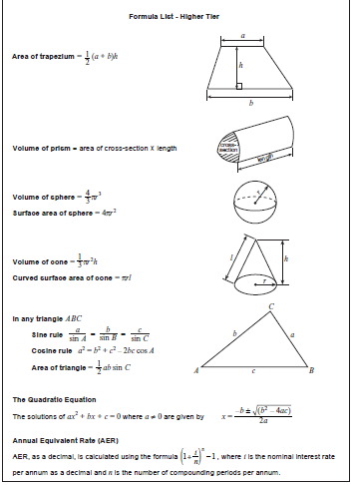

Slide 8
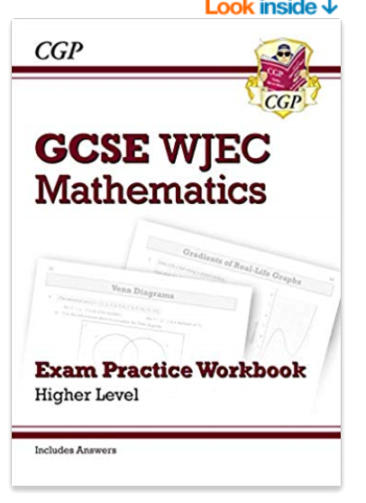
Support
After School Maths Club (Every day except Thursday)
MyMaths (booster packs for general revision and lessons for specific topic support)
Revision Workbooks can be found in most book shops and on Amazon

Slide 9
Cambridge IGCSE English language and Literature
The exams information
Notes:
All through exam no tiers

Slide 10
Language paper 1 – Reading Paper
2 hours 50% - 80 marks
Question 1 a-e – short answer comprehension questions 15 marks
Question 1 f – a summary task 15 marks
Question 2 a-c – short answer language questions 10 marks
Question 2 d – Language analysis question 15 marks
Extended response task 25 marks

Slide 11
Paper 2 – Writing paper
2 hours 50% - 80 marks
Directed writing task 40 marks
A choice of narrative or descriptive writing 40 marks

Slide 12
Cambridge IGCSE Literature in English (0475)
Paper 1 poetry and prose 1 hour 30 minutes 50% - 50 marks
(closed text)
Poetry essay response 25 marks
Prose essay response 25 marks

Slide 13
Paper 3 Drama
45 minutes 25% - 25 marks
(open text)
Drama essay response 25 marks

Slide 14
Paper 4 Unseen
1 hour 15 minutes 25% - 25 marks
Unseen poetry essay response 25 marks
OR
Unseen prose essay response 25 marks

Slide 18
Any questions?

