Slide 1
Welcome

Slide 2
Keeping Your Child Safe Online Alyssa Isaac & Gráinne Burns

Slide 3
What are young people doing online?
The same as adults!
Communicating
Learning
Gaming
Shopping
Streaming
Gambling

Slide 4
Current Digital Landscape
Notes:
Similarly to Wave 1, a quarter of children aged 8-17 said they had changed the date of birth on their profile since it was first created.* • Facebook (27%) and TikTok (25%), followed by X/Twitter (24%), and Instagram (23%), were the most commonly cited platforms. Which is consistent with Wave 1. • Proportions doing this were again greater among 8-12s for Snapchat (22%), TikTok (32%), Instagram (29%) and Pinterest (19%) Like Wave 1, four in five children aged 8-17 said they have never been asked to prove their age on any of the apps/sites, while a minority said they had been asked. • Compared to Wave 1, there has been a noticeable rise in the proportion of 8-17s who have been requested to verify their date of birth on Instagram and Facebook. • Across age groups, the proportion of children asked to prove their date of birth remained similar to Wave 1. However, compared to Wave 1, children aged 13-15 were more likely to say that they had been asked to verify their date of birth on Facebook (8% vs 21%) and YouTube (6% vs 14%). • When asked how they proved their age, 29-45% of children aged 8-17 said their parents/guardians/or someone else had done this for them.** • Up to a fifth said they had proved it themselves, via photo, ID, or bank information – increasingly likely for Snapchat, YouTube and Instagram compared to Wave 1.

Slide 5
Access to Violent Content
Notes:
Children had first seen violent content in primary school, and the content described by older children was markedly more violent While all children in the workshops had seen violent content, including those as young as 8, different risks emerged for children of different age groups. As illustrated in the diagram below, children we spoke to in their early to mid-teens (ages 13- 15) were most actively engaging with violent content, including sharing content with others. They told us this was due to the perceived popularity of the content and the desire for belonging and fittng in with what others their age were doing online.

Slide 7
Digital Landscape: The Risks
Gaming/addiction/gambling
Bullying-being bullied, online hate
Exposure to harmful materials (pro-ED, self-harming, violent content etc.)
“Fake news”/misinformation/AI-positive or not?
Grooming
Online pornography, ‘sextortion’, child sexual abuse
Online reputation, privacy and identity theft
Radicalisation/extremism

Slide 8
Impact on Mental Health
Notes:
According to Ofcom: children report feelings of anxiety, shame, and fear on encountering content promoting eating disorders suicide and self-harm.
Content can also encourage children to adopt attitudes and behaviours that cause harm to their peers and communities. For example, evidence links violent content to specific behaviours related to violence, such as leading children to perceive it as normal to carry knives. Over half of 11-14-year-old boys (52%) are aware of and have engaged with influencers tied to the ‘manosphere’. This may be contributing to a rise in misogyny among children: 70% of teachers reported a rise in sexist language in the classroom in the past 12 months,17 while the number of girls aged 13-21 who have received ‘sexist comments’ online has almost tripled in ten years (from 20% in 2013 to 57% in 2023). Pornographic content has been linked to increased risks of developing harmful sexual behaviours may be increasing the risk of indirect harm to women and girls.
Children with a mental health condition are four times as likely to have seen content promoting suicide or self-harm, and nearly three times as likely to have seen eating disorder in a four week period than those without any limiting or impacting conditions

Slide 9
How many of us know what they’re doing, or who they’re communicating with online? How can we support them to use the internet safely and responsibly?
How many of us would be comfortable with our children being out all day or night, not knowing who they’re with, or what they’re doing?

Slide 10
How can parents/carers help?
Talk to your child/ren
Model healthy behaviour
Set boundaries for device usage
Check privacy settings-use parental settings
Learn about popular apps/websites

Slide 11
Parental Supervision

Slide 12
Encouraging Discussion
Try to be non-judgmental and understanding
Practice active listening
Ask questions
Take your time responding
Talk about internet usage regularly
Notes:
Remember – children growing up today have always lived in a world with the internet. It’s a fundamental and ever present part of their daily lives, and has many benefits
Ask open questions, allow them time to think and respond, try to focus on what they’re saying
Your child may say something that makes you feel angry or worried. Reacting too quickly could shut down the conversation and make it unlikely your child will open up again in the future. Allow yourself time to collect your thoughts before responding

Slide 13
Questions
Which apps or sites do you use the most? What do you like about using them?
Who do you talk to online?
How do you keep yourself safe?
What kinds of things should we think about before posting something online, or sharing a photo?
What kinds of things worry you when you’re online?

Slide 14
Questions
How can you tell if the information you’re seeing online is trustworthy?
What kinds of things do you think are OK/not OK to share online?
Where can you go/who can you talk to if you need help?
What could you do if somebody was asking you to share information/photos that you weren’t comfortable with?

Slide 15
If You Need Help…
Reporting an incident to CEOP/NCA
Childline/Internet Watch Foundation: Report Remove (for reporting indecent images of children)
NSPCC Helpline
Notes:
CEOP - Child Exploitation and Online Protection Command – sits within National Crime Agency, helps protect children from online grooming

Slide 16
Safer Schools (new app)
Keep up to date with the current digital trends, threats, and risks to pupils online and offline.
Get digital safeguarding alerts and news sent directly to your devices so you’re in the know exactly when you need to know: now!
Find practical, useable advice on how to safeguard your child online.
Continue the lessons beyond the school gates, with safeguarding resources designed for home use.

Slide 17
Thank you!

Slide 18
Keeping your Child Safe

Slide 19
Topics we will cover
Vaping – new legislation
Sexual Offences – new legislation
Consent
Exploitation

Slide 20
Vaping
The Vaping Products Act 2024
Came into force on Monday 27th May 2024
It is now illegal to sell or supply vapes to under 18s
Police Officers can stop and search those under 18 believed to be in possession of vapes
Police Officers can seize and destroy vapes
From 1st September – advertising and display restrictions and regulations
Notes:
Tuesday, 21 May 2024
Legislation to introduce stricter regulations on the sale and promotion of vaping products, has today gained Royal Assent.
The Vaping Products Act 2024 will come into operation from Monday 27 May when the sale and supply of vaping products to under 18s will be prohibited.
The Act’s new advertising restrictions and display regulations will be introduced from Sunday 1 September. This will mean that for retailers accessible to those under 18, vaping products will no longer be permitted to be on open display.
Minister for the Cabinet Office, Kate Lord-Brennan MHK who promoted the Bill said:
‘It is really positive to be able to put this Act into operation following Royal Assent. The new Act will finally align us with the UK's age controls on the sale of vaping products, and it will surpass UK legislation by introducing new point of sale restrictions, meaning that the display and marketing of vapes will be restricted in retailers accessible to children and young people. This is an important move for the current and future health of young people.”
In preparing the Bill, Public Health engaged with parents, retailers and school leaders and work will continue with them to develop resources to support those who need it.
Visit www.gov.im/vaping for more information and answers to frequently asked questions.
19 Vaping Products Act 2024 –
(1) This section applies where a constable has reasonable grounds to believe that a person in any public place is — (a) under the age of 18; and (b) in possession of a vaping product.
(2) This section also applies where a constable has reasonable grounds to believe that any other person in any public place — (a) is in possession of a vaping product; and (b) has committed, or is likely to commit, an offence under this Act.
(3) Where a constable reasonably believes that subsection (1) or subsection (2) applies the constable may, for the purposes of the subsection, stop, detain and search the person referred to in it.
(4) A constable may seize any vaping product in the possession of a person to whom this section applies.
(5) Any vaping product so seized may be disposed of in such manner as the Chief Constable may direct.
(6) “Public place” means — (a) any highway; and (b) any place to which the public or a section of the public have access — (i) as of right, or by virtue of any express or implied permission; and (ii) on payment or otherwise.

Slide 21
Sexual Offences
Sexual Offences and Obscene Publications Act 2001
Section 16 – Child Sex Offences Committed by a Child or Young Person
Section 71 – Indecent Photographs
Section 114 - Distributing Images
Section 115 – Threatening to distribute Images
Notes:
Section 16 – A person ‘A’ under 18 commits an offence if ‘A’ does anything under sections 12-15 SOOPA which would otherwise be an offence if ‘A’ was aged 18 or over.
Section 12 – Sexual Activity with a Child (Sexual Touching)
Section 13 – Causing or Inciting a Child to Engage in Sexual Activity
Section 14 – Engaging in Sexual Activity in the Presence of a Child
Section 15 – Causing a Child to Watch or Listen to a Sexual Act
Section 18 – A person ‘A’ aged 18 or over commits an offence if ‘A’ meets or communicates on ONE or more occasions with a child under 16 and then subsequently meets or travels anywhere in the world (or child travels to meet them) with the intention of meeting and ‘A’ intends to do anything which would constitute an offence under this Act
Section 19 – A person ‘A’ aged 18 or over commits an offence if for the purpose of sexual gratification ‘A’ intentionally communicates with another person and the communication is sexual or intended to encourage ‘B’ to make sexual communications and ‘B’ is under 16
Section 49 – A person ‘A’ commits an offence if ‘A’ intentionally obtains for themselves the sexual services of ‘B’ and before obtaining such services ‘A’ (or another person on behalf of ‘A’) has made or promised payment to ‘B’ or another person and ‘B’ in under 18 (payment can be financial advantage / discharge of debt / provision of goods or other services)
Section 71 – Next Slide
Section 114 and 115 – A person ‘A’ commits an offence if ‘A’ intentionally distributes an intimate image of ‘B’ or ‘A’ threatens to record or distribute an intimate image of ‘B’ (with intent that ‘B’ believes the threat without consent and knowing or being reckless as to consent of ‘B’

Slide 22
Section 71 SOOPA
Notes:
Child is under 18
Indecent is defined under reasonable person test – include portrayal of nudity, the revealing of genitalia, sexual activity (whether solo or with others), penetrative activity
Photographs or pseudo photographs are those which depict ‘real’ images even if they have been altered, they still appear human or of actual people
Pseudo image is an image which has been made by computer-graphics software or otherwise and has the appearance of a photograph
This includes ‘selfies’ – so if teenager takes photographs of themselves would be classed as taking or making an indecent photograph

Slide 23
Consent
It is estimated that one in three women worldwide experiences physical or sexual violence
Worldwide up to 50% of sexual assaults are committed against girls under 16 years old
30% of women report that their first sexual experience was forced
FREE AND INFORMED CONSENT
Notes:
It is estimated that about one in three women worldwide experiences physical or sexual violence. • Worldwide, up to 50% of sexual assaults are committed against girls under 16 years old. • 30% of women report that their first sexual experience was forced. • An estimated 246 million girls and boys experience school-related violence every year. • Women who have been physically or sexually abused by their partners are more than twice as likely to have an abortion, almost twice as likely to experience depression, and in some regions, 1.5 times more likely to acquire HIV.
Free and Informed Consent --
They don’t want to do it!
They don’t understand what they are agreeing to
They don’t have enough information about sex or risks involved
They feel pressurized to say yes to sex
They are affected by alcohol or drugs and can’t think properly
There is a power imbalance, for example their partner is much older than them
Have conversation with children re consent – both females and males.

Slide 24
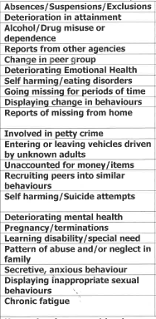
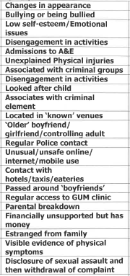
Exploitation
We are seeing a lot of youths exchanging sexual favours for vapes / alcohol / drugs
Main things to look for:
Secretive / anxious behaviour – especially with phone
Withdrawal from family
Unaccounted for money or items
Have the conversations with your children – check their phone / social media apps

Slide 25
Any Questions?

Slide 26
Isle Listen in Schools

Slide 27
Isle Listen in Schools
Early Intervention and Prevention
Evidence Based Service with Governance
1-2-1 Listening Service and Classroom Educational Sessions
The Team:
5 Wellbeing Practitioners &
3 Wellbeing Facilitators

Slide 28
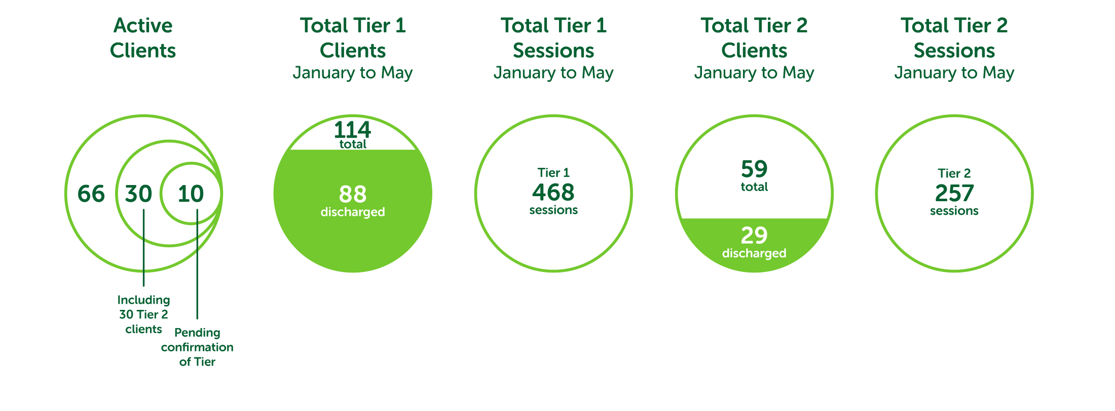
Notes:
Hi Ste/Libby – this slide and the next two are the stats Ste sent me in the email to focus on so I have redrawn these ones but none of the others. Let me know if you need the others too? Thanks, Henny

Slide 29
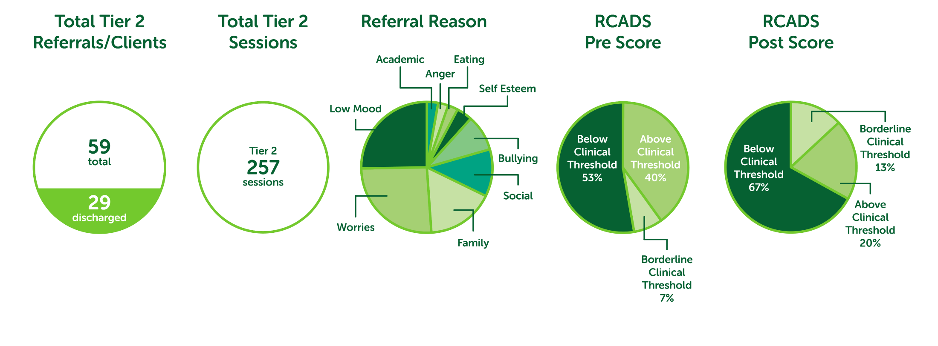
Notes:
You can add percentages in on here in place of the red text (don’t forget to change the colour afterwards). My graph tool wasn’t working in PPT so I couldn’t create them in here. If you need any of them changing please let me know!

Slide 30
