Slide 1
What you need to know about GCSE Maths

Slide 2
WJEC
WJEC is the Welsh Exam Board and is graded A* to G.
This summer students achieved a brilliant set of results of 78.4% A*- C grades with our top sets achieving 30 A* grades.

Slide 3
The Options
Currently we have sets 1- 6 studying the Welsh Exam Board WJEC. This allows for us to continue with lettered grades (A*-G) instead of numbered grades.
Set 7 are focusing on Entry Level Qualifications at this year with a view to sit their GCSE once completed the Entry Level.

Slide 4
The Tiers
There are 3 tiers in WJEC Mathematics:
Higher (Grades A*-C) Sets 1 & 2
Intermediate (Grades B-E) Sets 3, 4, 5 & 6
Foundation (D-G) Set 7 (once Entry Level is completed)

Slide 5
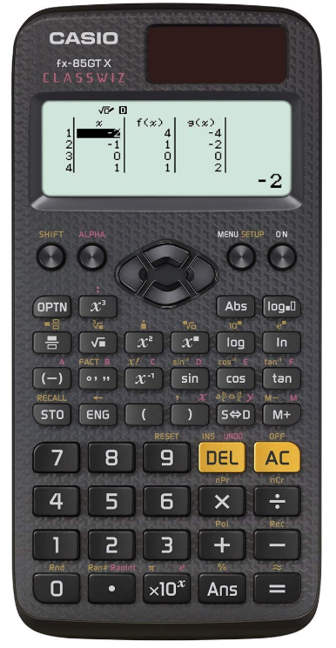
Equipment
Students will need the following equipment in order to be successful in both lessons and during exams.
Black Pen (Ball-point for exam requirement)
Pencil
Ruler (30cm)
Protractor
Compass
Scientific Calculator (Recommended a CASIO FX – 83GT – X)
It is important that students are regularly attending lessons with the correct equipment so they know how to use it in the exam.
Notes:
Old Casio’s is still fine to use for GCSE. Geometry set.

Slide 6
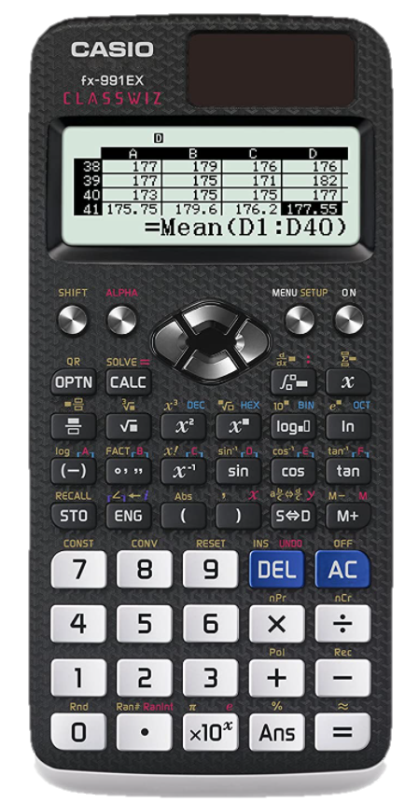
Equipment
If your child is wanting to go on to study A Level maths then it is essential they have a Classwiz calculator (Casio FX – 991EX, this is due to the changes in specification).
These can be purchased from Amazon, Tesco and Vannin Office Point in Ramsey.

Slide 7
The Papers
For all tiers there are 2 papers to sit.
Higher/Intermediate are each 1 hour and 45 minutes long.
Foundation are each 1 hour and 30 minutes long.
There is a non-calculator and a calculator paper.
Each paper is worth equal marks.
All papers have a formula page on the second page and one question will also have 2 marks awards for Quality of Written Communication (QWC).

Slide 8
QWC
There are 2 marks available in WJEC for Quality of Written Communication (QWC).
QWC marks are awarded for how the students have explained their answers. Examiners are not looking for paragraphs but they will be focusing on how they have presented the answers (logical manner, correct use of mathematical symbols, all workings shown) and how they have explained their steps (have they made it clear what they are doing, have they used correct punctuation and spellings)

Slide 9
Mock Exams
Pupils will sit a mock (non-calculator and calculator) in March of Year 10 to ensure they are sitting the correct tier. This will not be a full paper but will only include content covered so far.
Pupils will also sit mocks in Maths in December and March of Year 11.

Slide 10
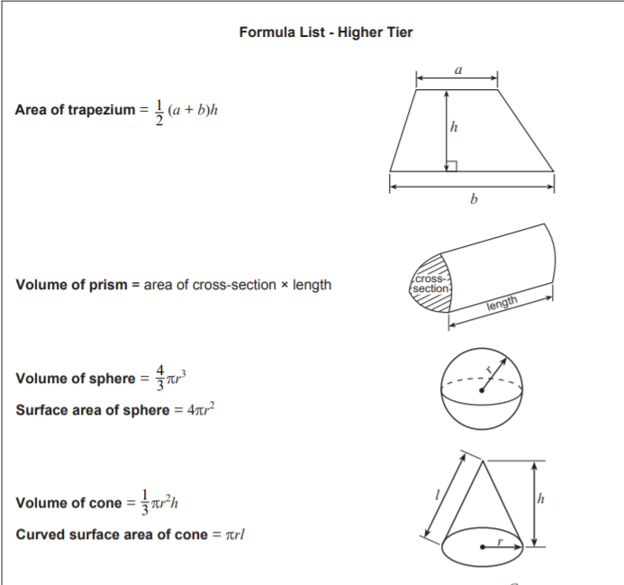
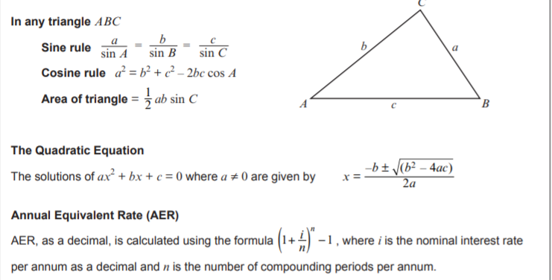

Slide 11
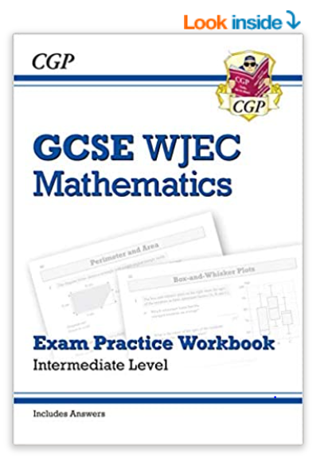
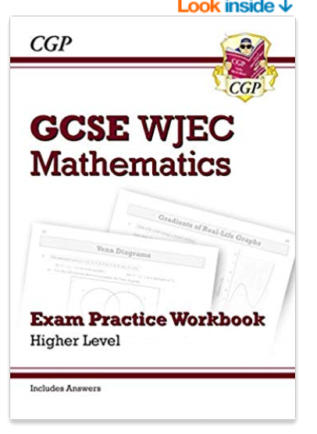

Support
After School Maths Club (Specific for GCSE)
MyMaths (booster packs for general revision and lessons for specific topic support)
Revision Workbooks can be found in most book shops and on Amazon
GCSE Pod
Notes:
There is a revision guide that matches these workbooks. If you are unsure to which tier book to purchase please ask your class teacher.

Slide 12
Cambridge iGCSE English Language and Literature

Slide 13

English Language
The subject code for this GCSE is: 0500
Paper 1
80 marks 120 minutes 50%
This paper is split into 3 big questions.
Q1a-e: small comprehension questions 15 marks
Q1f: summary skills 15 marks
Q2a-c: short answer language questions 10 marks
Q2d: language analysis question 15 marks
Q3 – empathic response to a text 25 marks
Paper 2
80 marks 120 minutes 50%
This paper is split into 2 parts.
Section A: response to reading. Could be a letter, script, article, etc. 40 marks
Section B: descriptive or narrative writing. You answer one question from a choice of four 40 marks

Slide 14
English Literature
The subject code for this GCSE is: 0475
Paper 1: Poetry and Prose
50 marks 90 minutes 50%
This paper is split into 2 parts.
Section 1: Poetry
  Poetry response based on one of the 15 poems studied in the classroom. 25 marks
Section 2: Prose
  Response to the prose text studied in the classroom. 25 marks
Paper 3: Drama
25 marks 45 minutes 25%
Choice of 2 questions based on the drama text you have studied (A Streetcar Named Desire, Tennessee Williams) – write a response to the one you prefer.
25 marks
Paper 4: Unseen
25 marks 75 minutes 25%
Unseen poetry response OR unseen prose response.
25 marks

Slide 15
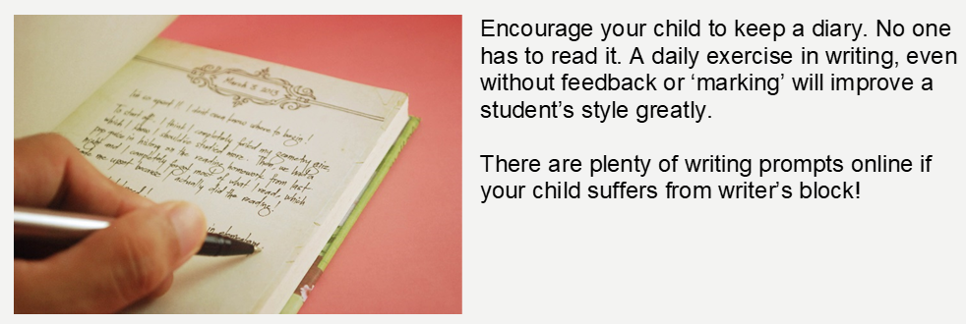

Slide 16

Online resources:
Your child’s classroom Teams pages will have information on them about specific exam material and content of texts studied.
www.vocabulary.com is a fun way to get to grips with a wider range of vocabulary
www.bibliomaina.com offers an extensive collection of non-copyright literature texts
www.thepaperboy.com offers more than 10,800 online newspapers from around the world.

Slide 17
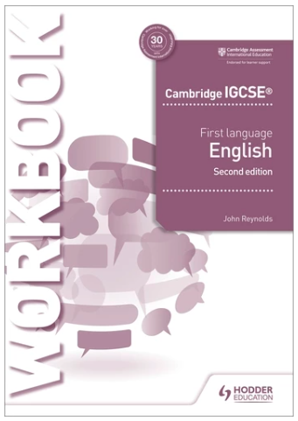
REVISION Workbook
The school have purchased revision workbooks that are endorsed by Cambridge.
They are perfect for revision at home ready for exams, as well as developing confidence and skill.
They will be available for purchase on Parent Pay
They will cost £8 each – this is a reduced cost.

Slide 18
KS4 English Club
w/c 18th September | Language Paper 2 Q2+3 and revision space
w/c 25th September | Structuring a Literature essay and revision space
w/c 2nd October | Language Paper 1 Q2d and revision space
w/c 9th October | A Streetcar Named Desire—Revision Part 1 and revision space
w/c 16th October | A Streetcar Named Desire—Revision Part 2 and revision space
HALF TERM
w/c 30th October | Language Paper 1 Q1a-e & Scanning and skimming skills and revision space
w/c 6th November | Language Paper 1 Q3 and revision space
w/c 13th November | Language Paper 2 Q1 and revision space
w/c 20th November | Poetry revision and revision space
w/c 27th November | Prose revision (chapters 1-10) and revision space
w/c 4th December | Revision space (primarily for year 11)
w/c 11th December | Language Paper 1 Q2a-c and revision space
Tuesday 4-5pm Rm206
Thursday 1-1:30pm Rm206

Slide 19
Any questions?

