Slide 1
Ramsey Grammar School
Ski Trip – Italy
Sat 30th March – Sat 6th April 2024

Slide 2
The Staff
Mr Eyres- Trip Leader
Mr Lillie- Former Trip Leader
Mrs Lewis- Former Trip Leader
Mrs Bullock- PE Teacher, DHOY10
Mr Ideson- Head of Boys PE
Mrs Mooney- Head of Girls PE
Mrs Bowden- PE teacher
Mr Hart- Geography Teacher

Slide 3
First Aid Qualifications
Mr Ideson has- First Aid at Work.
Mrs Bullock has- First Aid at Work.

Slide 4
The Company
True North
This is the first time we have used the company.
However, KWC have used them successfully in recent trips.
Fully insured and ABTA member.

Slide 5
Trip Details - Departure
The flight will be a chartered plane. Only for RGS, Buchan and CRHS pupils.
IOM to Bergamo (Milan) 10:00-13:10
Bergamo to IOM 15:00-16:25
Please meet at the airport for 08:00

Slide 6
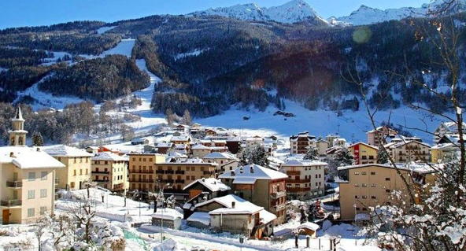
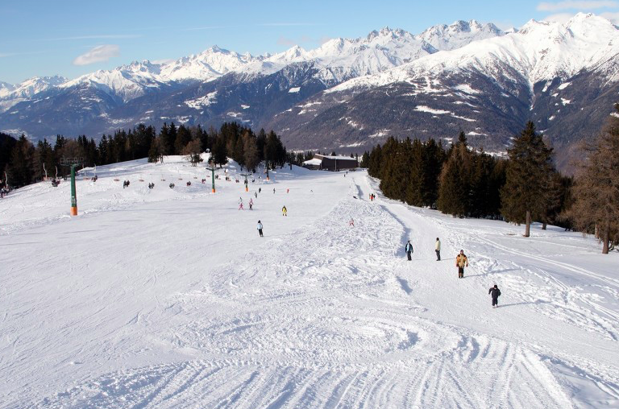
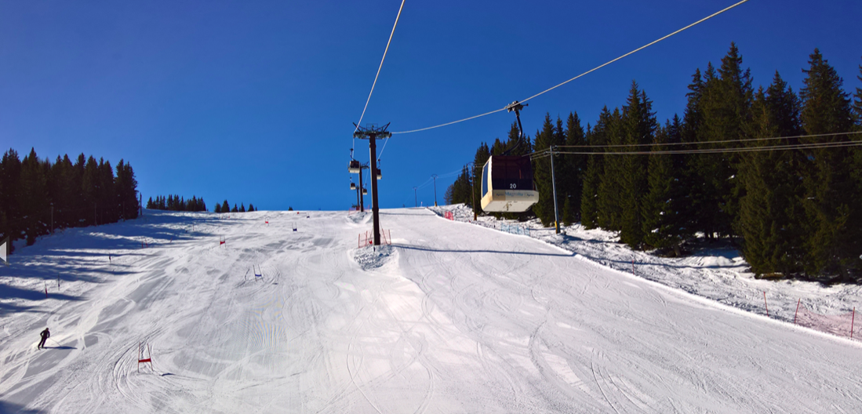
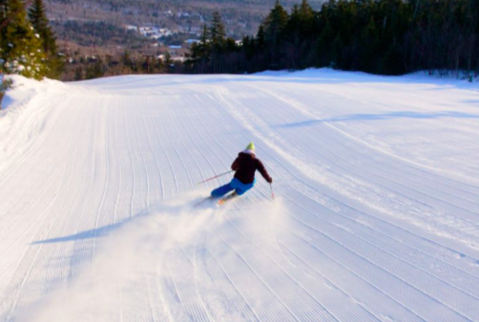
Aprica

Slide 7
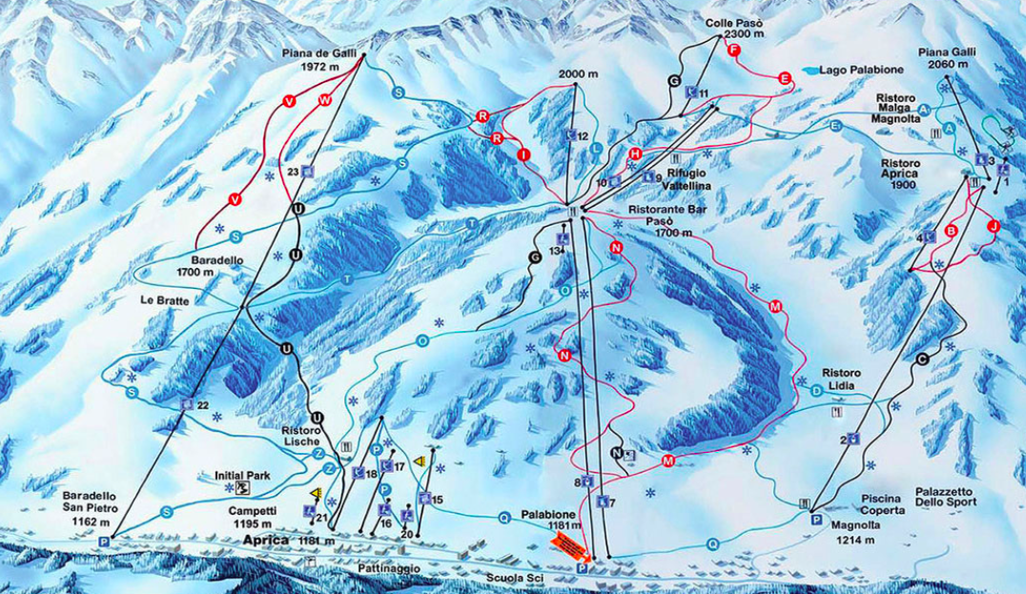

Slide 8
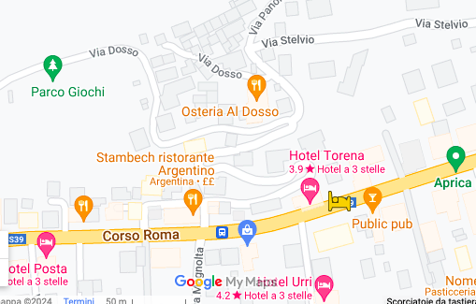
Hotel Torena
2 ½ hours drive from Milan
200m to the slopes.
Just our group in the hotel
Comfortable rooms all ensuite.
All meals will be eaten at the hotel
Large restaurant area.
Ski/boot room
Some additional accommodation in hotel owned apartments 50m away.

Slide 9
Rooms
The group will be split between the 2 sites. The staff will also be split between the 2 sites.
We will know the room numbers closer to our departure date.
Rooms will be with friendship groups as far as possible.

Slide 10
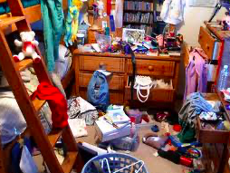
Please try and keep rooms tidy
Things don’t get stolen- but……

Slide 11
Skiing
There will be 4 hours of instructed skiing per day, for the 6 days of our lift pass.
Students will not be allowed to ski unless they are accompanied by the instructors.
Pupils will be split into ability groups, to allow progression at a similar rate. The ski ability has been collected by the ski company.

Slide 12
What is included?
Ski, pole and boot hire
Helmet- you must wear this
Lift pass (don’t lose it though)
3 hot meals per day
Insurance
Evening activities

Slide 13
What is not included
Jacket
Trousers
Hat, gloves, goggles and sunglasses.

Slide 14
Evening Activities
We will work with the tour provider to put together a plan for evening activities
The resort is small and traditional.
We do have the full use of the hotel

Slide 15
Fitness
This is an action packed holiday.
Every night pupils will go to bed shattered.
Each session will be very demanding, especially for beginners.
We will run a fitness session for pupils on a Tuesday lunch in the East Gym
You cannot be fit enough!

Slide 16
Climate.
In April temperatures will be cold but should not be freezing.
Warm clothes will be needed. The secret is layers. Thermals are highly recommended.
Ski Jacket and Ski trousers will be needed.
Good gloves are a life saver.
TK Max often has ski wear in store.
Millets and Mountain Warehouse also have good quality ski wear.

Slide 17
On the slopes
Thermals and thick ski socks
Waterproof ski trousers and ski jacket
Sun screen/ SPF Lip balm
Gloves
A buff can be useful, especially if it starts to snow
Goggles- sunglasses also an option, unless it is snowing.

Slide 18
Other Clothing
Casual clothes can be worn for the journey.
Jeans, tracksuits
sweat top / jumper, t shirts
bring your swimwear- just in case we can get to a pool.

Slide 19
True North Web Page
Personal details to be uploaded
Information about the flights, resort and hotel
Discount for Dare 2b clothing

Slide 20
Baggage Allowance
Check in luggage.
Weight limit of 23kg per bag.
1 Bag per pupil has been pre-paid
Don’t go overboard with equipment.
If you have your own skis, please let Mr Eyres know a.s.a.p. so that they can be booked on the plane.

Slide 21
Hand Luggage
Should be kept to a minimum- the current dimensions equate to the size of a laptop holdall.
No sharp objects e.g. darts.
No liquids in containers over 100ml, all in a clear plastic bag.

Slide 22
Passports
Pupils must hand their passports in to the West office on Friday 22nd March. Your designated teacher will then return them to you on the plane on the return journey.
Make sure you have 6 months left on your passport.

Slide 23
Pocket Money
Approximately £80 sterling in Euros.
£10 for the airport, but we will not have much time.
These are guidelines only.
As the accommodation is full board then pupils will only have to buy snacks and drinks (and gifts for parents)
Please hand spending money in to your teacher at the airport. This must be in an envelope with your child’s name on it.
Each evening pupils will be given the chance to withdraw money from their envelope.
THE PUPILS WILL BE RESPONSIBLE FOR ANY MONEY NOT HANDED IN TO THE TEACHERS AND TAKEN BY THEMSELVES

Slide 24
Medication
The children are responsible for their own medication (inhalers, sickness pills etc).
However, if you wish us to carry their medication and look after it then it must be labelled and given to Mrs Bullock at school by Friday 22nd March.

Slide 25
Insurance
Our insurance is through AIG, under The Department of Education, Sport and Culture. This is a policy that is used for all school trips across the Island.
Valuables e.g. mobile phones, AirPods, portable consoles etc. should be kept to a minimum.

Slide 26
Emergency contact details
Mr Eyres will have a master copy of all pupil’s emergency contact details.
In addition, each teacher will have a list of contacts and medical details for their group.
When we get to the airport, we will give pupils an emergency contact slip with Mr Eyres’ phone number number on it.
Mr Eyres contact number- 07510623417

Slide 27
Behaviour
We will have an amazing trip, but there are some ground rules.
Be organised.
Be on time and give it your best effort every session.
Think of others and be polite
We are representing the school and the Isle of Man.

Slide 28
Common Questions?
Yes, the hotel has Wi-Fi.
Students can bring mobile phones.
We don’t know what the food will be.
Skiing outside of lesson time- Our insurance policy will not cover us for this
Any questions?

