Slide 1
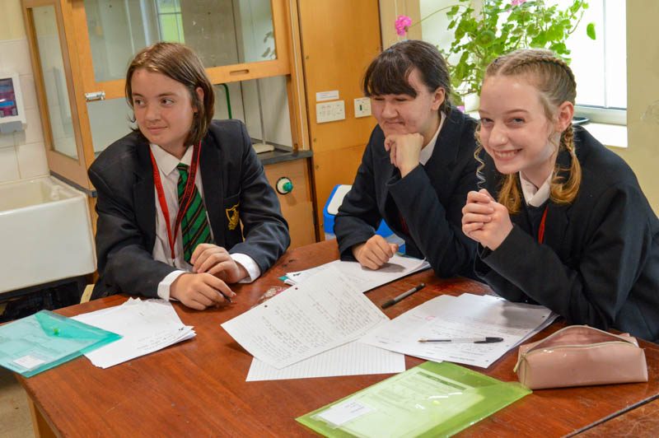
A Warm Welcome to Ramsey Grammar School Y6 Transition Evening
Invest, Believe, Achieve Together – Responsibility | Growth | Success

Slide 2
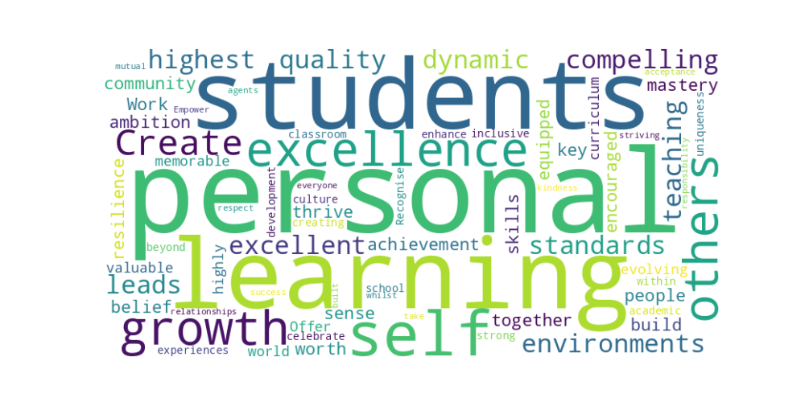
Our School Motto
Invest, Believe, Achieve Together
Our Values
Responsibility
Growth
Success

Slide 3
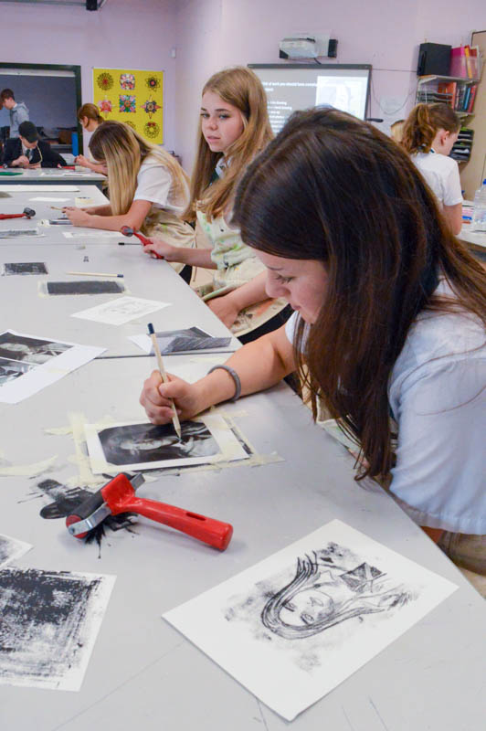
Main Priorities for our Students
Health, happiness and safety​
Decency and kindness​
Respect and positive relationships​
Resilience and determination​
Excellent achievement and successful futures.​
Invest, Believe, Achieve Together – Responsibility | Growth | Success

Slide 4
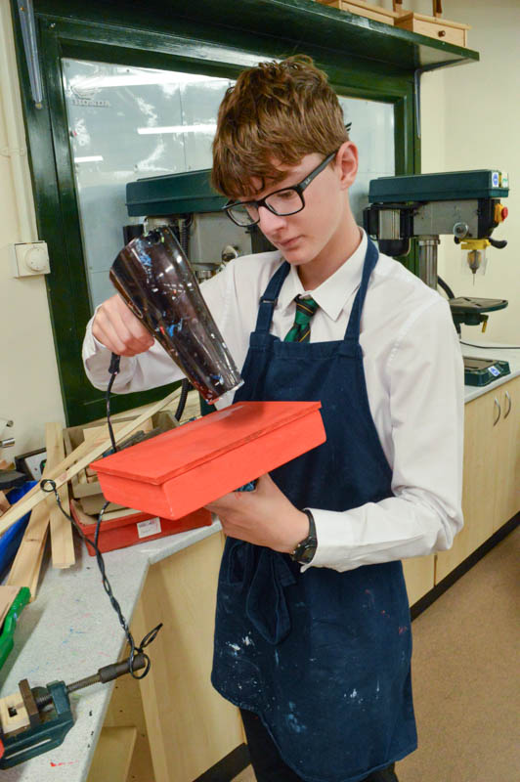
School Priorities for 25/26
Improve student attendance to reach a target of 96%
Increase student engagement and ownership of learning.
Further improve student progress.
Enhance the use and effectiveness of assessment
Invest, Believe, Achieve Together – Responsibility | Growth | Success

Slide 5
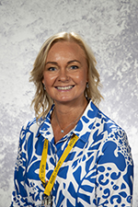
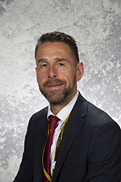
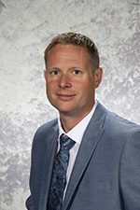
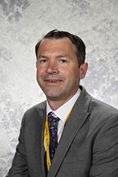
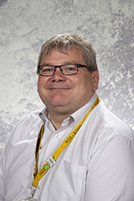
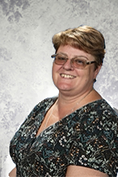
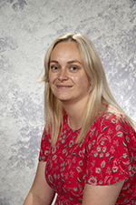
Who’s who? Senior Leadership Team
Mrs Taylor
Headteacher
Mr Smith
Deputy Headteacher
Mr Eyres
Deputy Headteacher
Mr Wood
Assistant Headteacher
Mr Flynn
Assistant Headteacher
Mrs Cayzer
School Business Manager
Miss Ball
School Office Manager
Notes:
Look at page 10 in the KOLB booklet and draw your kite shape from page 3 onto chart to see what your basic strengths are.
Make a note of strengths and areas for development. Suggest further reading pgs 11 – 15
When you have read pages 1 and 2 try to complete the grid on page 3. We may begin a learning process in any of the four phases of the learning cycle and a well-rounded learning process would cycle through all four phases. However, individuals may sometimes skip a phase in the cycle or focus primarily on just one. Kolb’s theory tells us that to optimise learning we should recognise where this happens and develop ways of strengthening learning skills that are outside of our own preferences. Kolb explains that people have different preferences in the way they approach learning based on two pairs of variables – how they approach a task and how they think or feel about it. The combination of these leads to four distinct preferences or learning styles.
Principles of adult learning
Diverging (feeling and watching – CE/RO): These people are able to look at things from different perspectives. They are sensitive. They prefer to watch rather than do, tending to gather information and use imagination to solve problems. They are best at viewing concrete situations from several different viewpoints. Kolb called this style diverging because these people perform better in situations that require ideas-generation, for example, brainstorming. People with a diverging learning style have broad cultural interests and like to gather information. They are interested in people, tend to be imaginative and emotional, and tend to be strong in the arts. People with the diverging style prefer to work in groups, to listen with an open mind and to receive personal feedback.
Assimilating (watching and thinking – AC/RO): The assimilating learning preference is for a concise, logical approach. Ideas and concepts are more important than people. These people require good clear explanation rather than practical opportunity. They excel at understanding wide-ranging information and organising it in a clear logical format. People with an assimilating learning style are less focused on people and more interested in ideas and abstract concepts. People with this style are more attracted to logically sound theories than approaches based on practical value. This learning style is important for effectiveness in information and science careers. In formal learning situations, people with this style prefer readings, lectures, exploring analytical models and having time to think things through.
Converging (doing and thinking – AC/AE): People with a converging learning style can solve problems and will use their learning to find solutions to practical issues. They prefer technical tasks, and are less concerned with people and interpersonal aspects. People with a converging learning style are good at finding practical uses for ideas and theories. They can solve problems and make decisions by finding solutions to questions and problems. People with a converging learning style are more attracted to technical tasks and problems than social or interpersonal issues. A converging learning style enables specialist and technological abilities. People with a converging style like to experiment with new ideas, to simulate and to work with practical applications.
Accommodating (doing and feeling – CE/AE): The accommodating learning style is hands-on, and relies on intuition rather than logic. These people use other people’s analysis, and prefer to take a practical, experiential approach. They are attracted to new challenges and experiences, and to carrying out plans. They commonly act on gut instinct rather than logical analysis. People with an accommodating learning style will tend to rely on others for information, rather than carrying out their own analysis. This learning style is prevalent and useful in roles requiring action and initiative. People with an accommodating learning style prefer to work in teams to complete tasks. They set targets and actively work in the field, trying different ways of achieving an objective.
Ask participants to complete the section Kolb Implications for your work with adults (Appendix 8)
10 mins
5

Slide 6
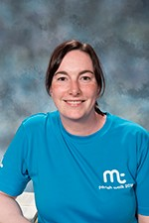
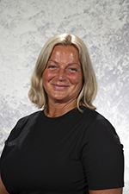
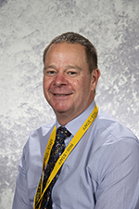
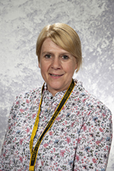
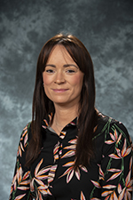
Who’s who? Year 7 Pastoral Team
Miss Johnson
Head of Year 7
Mrs Bullock
Deputy Head of Year
Mrs Corrin
Leader of
Safeguarding
Miss Duke
Pastoral Leader
Mrs Crowe
Pastoral Leader
Mrs Cretney
Pastoral Leader
Mr Wilson
SENCO
Invest, Believe, Achieve Together – Responsibility | Growth | Success

Slide 7
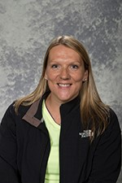
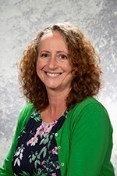
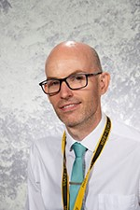
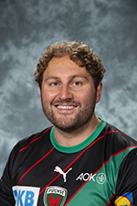
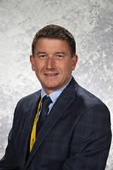
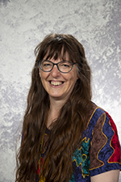
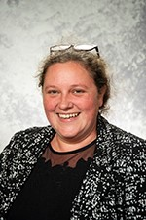
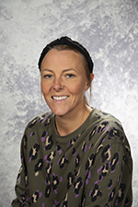
Year 7 Tutor Team
7A
Mrs Mooney
Mrs Maloney
7S
Mrs Bowden
Mrs Stevenson
7B
Mr Swinhoe
7C
Mr Keenan
7R
Mr Lillie
7V
Dr E Spencer
Invest, Believe, Achieve Together – Responsibility | Growth | Success

Slide 8
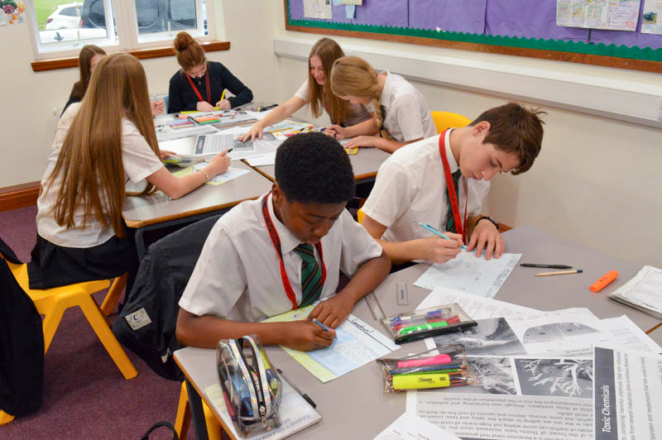
Equipment for great learning
All students must have the following equipment every day for school to ensure they are ready to learn:
Stationary - 2 black pens, a green pen, highlighter, 2 pencils, rubber, ruler, compass, protractor and a scientific calculator (Casio fx-83GTCW-W)
Pencil case
School bag
Planner issued by school
Water bottle
Invest, Believe, Achieve Together – Responsibility | Growth | Success

Slide 9
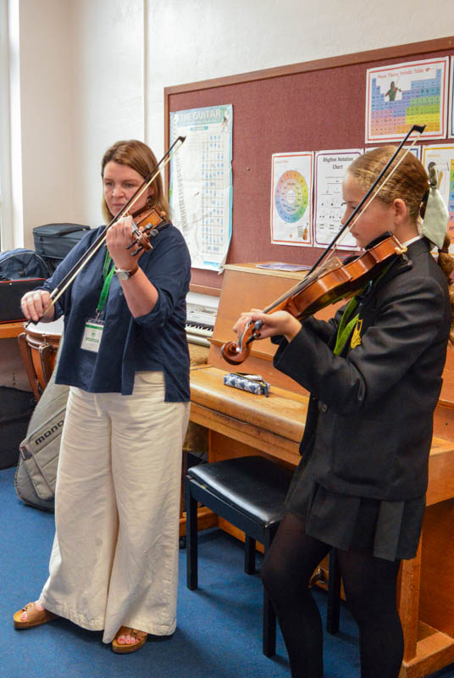
Looking the part for learning
Uniform – the full list is in your booklets
What is not permitted?
No lycra or skintight trousers – ensure trousers are formal material and have a button and zip at the front.
No skater style skirts – skirts must have a panel at the top and be pleated.
No piercings (including plastic) apart from in the lobule part of the ear.
No extreme hair colours.
NO MOBILE PHONES – switched off and in bags during school. Confiscated until the end of the day if they are seen or heard.
Invest, Believe, Achieve Together – Responsibility | Growth | Success

Slide 10
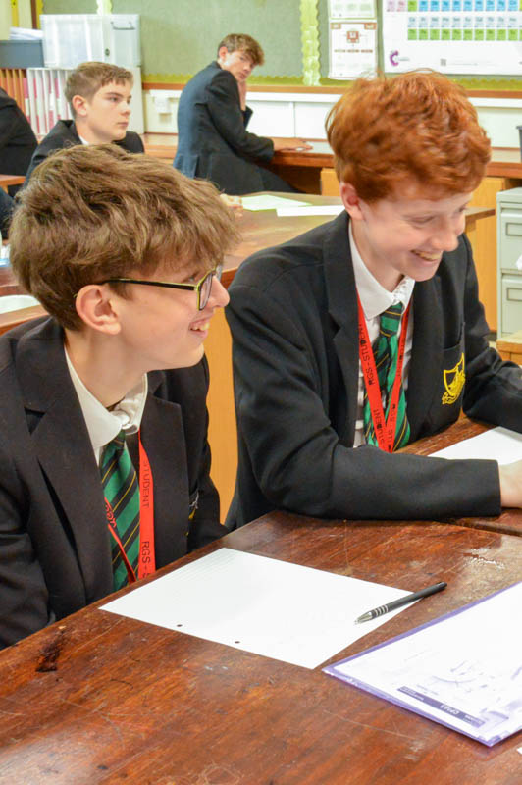
Typical Day for Y7
08:35 - 08:40 Arrive at school and go to East yard.
08:45 - 09:05 Tutor time / Assembly
09:05 - 09:55 Lesson 1​
09:55 – 10:45 Lesson 2​​
10:45 – 11:05 Break Time​
11:05 – 11:55 Lesson 3​
11:55 – 12:45 Lesson 4​
12:45 – 13:35 Lunch Time​
13:35 - 14.25 Lesson 5​
14:25 - 15.15 Lesson 6​
15:15 - 16:00 Home time or extra-curricular clubs ​
Invest, Believe, Achieve Together – Responsibility | Growth | Success

Slide 11
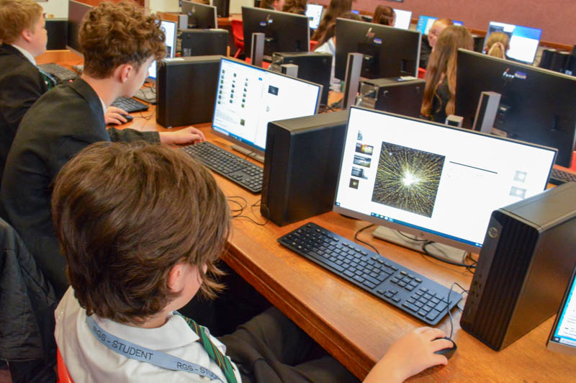
Attendance
We have set an ultimate target of 96%
This still means that 10 school days have been missed.​
If your child is ill, please inform the School on our absence line.​
If we do not receive a phone call by 10:00am we will text you.​
Please let us know about any existing medical conditions or any medication that your child needs to take as we have arrangements for this.​
Holidays during term time are strongly discouraged and may not be authorised unless in exceptional circumstances.​
Invest, Believe, Achieve Together – Responsibility | Growth | Success

Slide 12
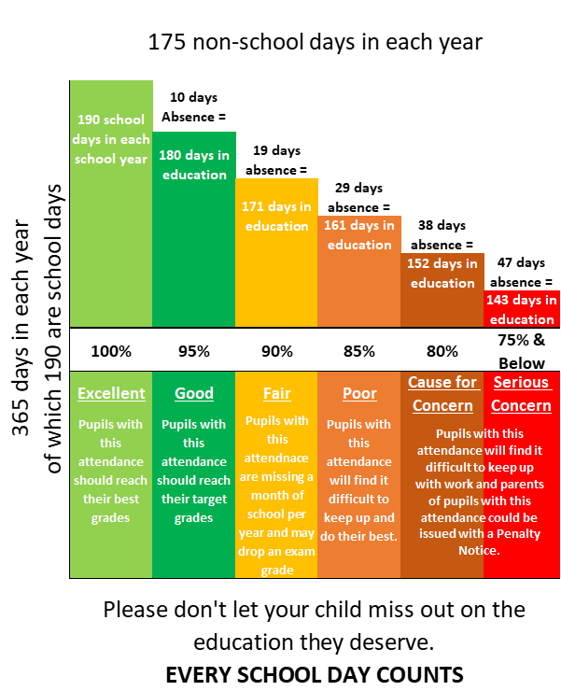

Slide 13
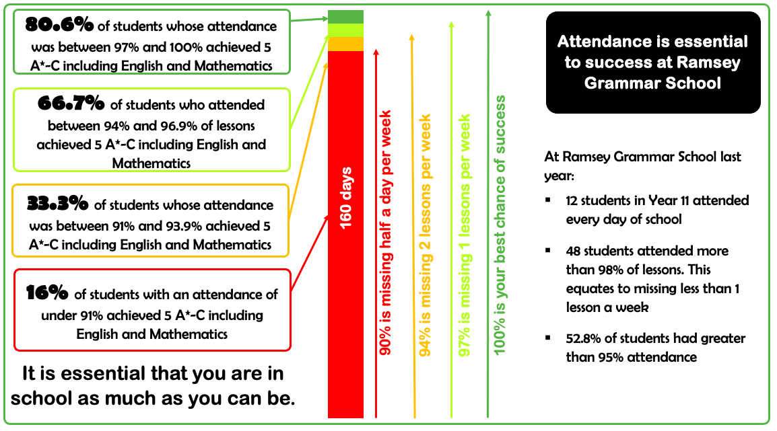

Slide 14
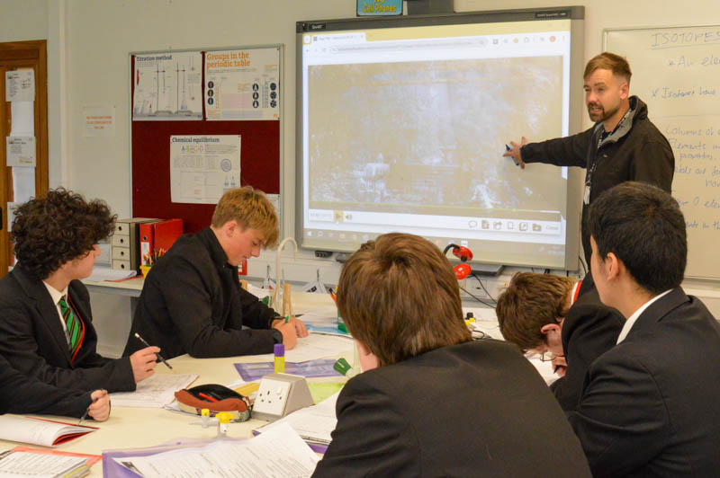
Teachers will:
communicate all behaviour instructions to ensure that they are clear, concrete and sequential.
collectively share and model behaviour in our school, by speaking to all with respect, empathy, kindness and understanding.
not shout at our students. ​
welcome students warmly and check uniform as they enter the classroom. Meet, greet, SMART and seat. ​
check that students have placed planners and equipment onto the desks and that bags and coats are stored away safely and neatly. ​
positively encourage students to be respectful and co-operate to create a conducive learning environment. ​
actively encourage engagement in learning. ​
ensure that we have clear consistent entry and exit routines in the learning environment. ​
praise and celebrate lesson achievements. ​
dismiss classes in an orderly manner.
Invest, Believe, Achieve Together – Responsibility | Growth | Success

Slide 15
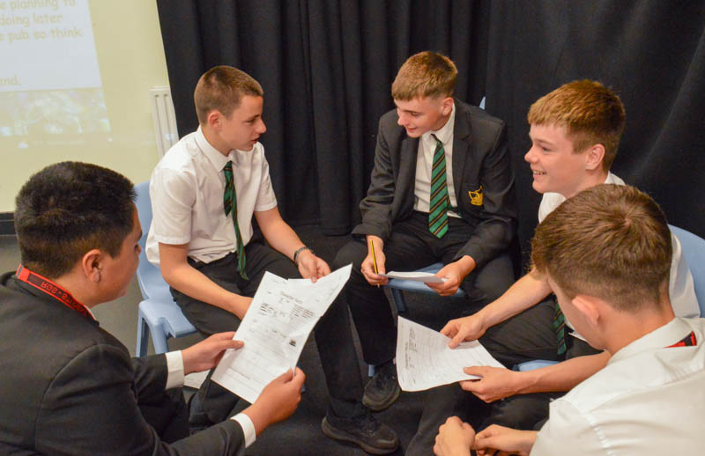
Students will:
be respectful and polite when speaking to others. ​
arrive to lessons before the bell, line up quietly outside the classroom and take off their coat.​
enter the room calmly, store their bag safely and place their planner and equipment on the desk. ​
begin immediately the task that is waiting for them. ​
pay attention when others are speaking. ​
complete the work set to the best of their ability. ​
record homework in their planner and complete it on time, to the best of their ability.
always wear uniform correctly.
always keep to the left whilst walking around school and ​ behave in a calm manner. ​
put litter in the bin and take pride in the environment. ​
Invest, Believe, Achieve Together – Responsibility | Growth | Success

Slide 16
Communication with parents
Planners – communication is a two-way process so please ask your child to see their planner and you can write notes for teachers too.
Arbor – this is our main communication tool where you will receive text messages and emails informing you of different things. More details will follow about the Parent App in October ‘25
Email address and phone contacts – these are essential so please ensure we are kept up to date with any changes. Please complete the Microsoft Form by 27 June 2025
RGSenquiries@sch.im – parents can email this address and we have 5 working days to respond.
Achievement reports – will be sent home three times a year.
Progress Day – Wednesday 11 February 2026
School website & Safer Schools App.
Mobile phones are NOT allowed in school therefore, students are not to use them as contact with parents. School will call parents if needed and parents can call our school office
Invest, Believe, Achieve Together – Responsibility | Growth | Success

Slide 17
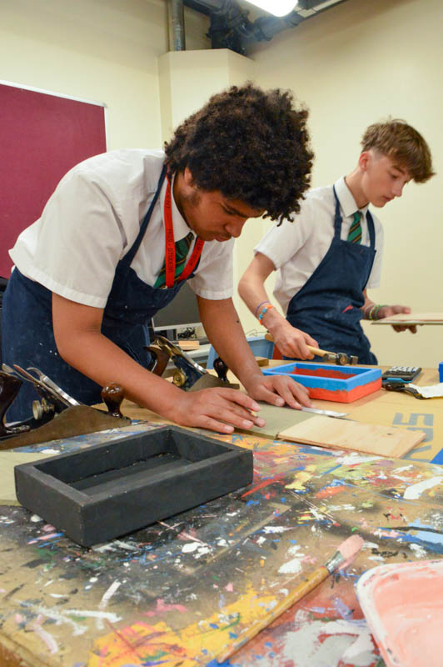
Start of Term Arrangements
Your child will start with us on Wednesday 03 September 2025
Arrive in school for 8:35 and meet on East yard where tutors will meet them.
8:45 Assembly with Mrs Taylor & Miss Johnson.
With tutor for the morning & then lessons from 11:05.
Year 7 will go to lunch early for the first week.
Invest, Believe, Achieve Together – Responsibility | Growth | Success

Slide 18
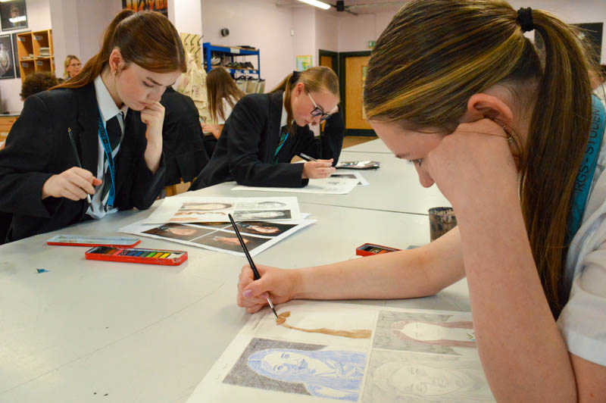
Welcome Days Arrangements 2 & 3 July 25
What will your children experience?​
Two full days at RGS starting from 8:40 to 15:15
Each day will arrive at the West Hall where they will be greeted by staff
Meet tutors
Different lessons throughout the days
Experience school lunches and social times (bring money with you)
Try our school transport is using buses.
School tour
Different activities
​
Invest, Believe, Achieve Together – Responsibility | Growth | Success

Slide 19
This poem is one that resonates, and our aim is to ensure that RGS is a place for children to learn to have patience, confidence, appreciation, justice and faith.
Invest, Believe, Achieve Together – Responsibility | Growth | Success

